Slide 1
Azure Subscription
To get the most out of today’s sessions, you may want to follow along with your own Azure Subscription.
If you do not have an MSDN Subscription:
You will need
Outlook.com, Hotmail.com, or other Microsoft ID,
Cell Phone,
Web Browser,
Credit Card
Open your browser and navigate to: http://manage.windowsazure.com.
Select Try it now.
Create a 30-day trial subscription.
If you do have an MSDN Subscription:
Open your browser and navigate to: http://msdn.microsoft.com and sign in to your account.
Open your MSDN Subscriptions.
Select Activate Windows Azure

Slide 2

Welcome
Streaming Events with Azure IoT Hub
David Buckingham
Senior Consultant
Custom Application Development
Notes:
Good morning everyone.
My name is… and I am a… with KiZAN Technologies.
Today we are exploring how to stream and collect events using the Azure IoT Hub.
Prior to joining KiZAN, I spent 13 years working for a systems integrator developing custom software solutions for the automotive, packaging, metals, food-and-beverage and many more industries.
After a number of years, we partnered with machine tool builders to “cloud-enable” their machines such as CNC machining centers, grinders, lathes, welders, robotic assembly cells, etc.
Before the “Internet of Things” we were learning about the difficulties device identity management, authentication, sharding, aggregating data at cloud scale, etc.
Icons - https://www.microsoft.com/en-us/download/details.aspx?id=41937

Slide 3


Prerequisites
To follow along with the examples during this session, the following prerequisites must be met:
Visual Studio 2015, Community Edition or greater | http://www.visualstudio.com
Azure Subscription, or trial | http://azure.microsoft.com
Notes:
This talk is meant to be an interactive, hands-on lab experience.
The following prerequisites will be needed:
Visual Studio 2015, Community Edition or greater
Azure Subscription, or trial

Slide 4

http://bit.ly/StreamingEventsWithAzureIoTHub

Slide 5
Objectives
IoT and Azure IoT Hub
Create an IoT Hub
Device Management
Device-to-Cloud Messaging
Cloud-to-Device Messaging

Slide 6
What is the
Internet of Things?
Notes:
The Internet of Things is still a very young and growing space.
The definition itself is very fuzzy, and the implementation can be even fuzzier.
How are devices identified?
What technology is used? RFID, NFC, Bluetooth, Wi-Fi
Do the devices talk directly to the “cloud”, or do they route through a concentrator or protocol gateway?

Slide 7
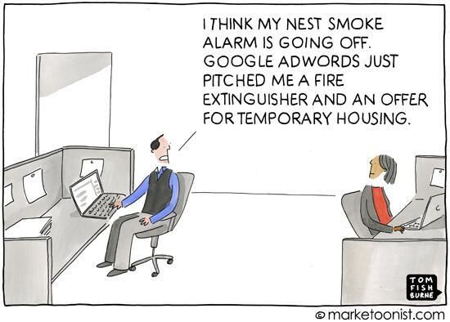
Notes:
It’s interesting to see everyone’s take on IoT.
We’re use to the concept of devices sending/receiving data, so long as those devices are PCs, laptops, mobile devices, servers, routers, etc. So why is the IoT so “foreign”?

Slide 8
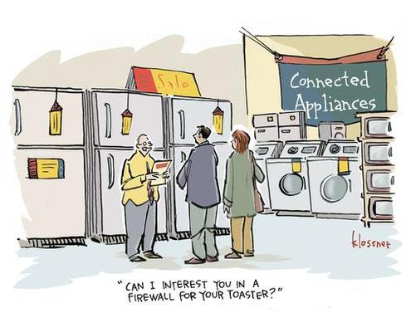
Notes:
It’s also fun to think about what IoT could mean to our most basic everyday appliance or product.

Slide 9
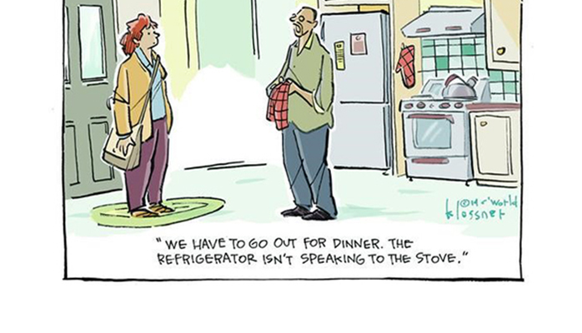
Notes:
We become so dependent on technology, what happens when the refrigerator can’t talk to the stove? Time to go out for dinner!

Slide 10
What is IoT?
“Things having identities and virtual personalities operating in smart spaces using intelligent interfaces to connect and communicate within social, environmental, and other user contexts.”
“Internet of Things in 2020: A Roadmap for the Future”
European Technology Platform on Smart Systems Integration (EPoSS)
http://www.smart-systems-integration.org
Notes:
As I’ve said, the definition of IoT can be fuzzy, it is simply a term placed on a class of technology, or advancement of technology, and not necessarily a “thing”.
Devices have Identities.
Devices have behaviors, or personality.
Devices which connect in a micro-ecosystem: among themselves or to the cloud forming a broader picture
Devices are extended to use existing technologies such as Bluetooth, RFID, NFC, Wifi, etc.
The term “devices” includes consumer electronic products, or systems in any number of markets and industries.

Slide 11
What is IoT?
Consumer Electronics
Wearables
Home Automation
Appliances
Manufacturing
Process Control
Performance Monitoring
Medical
Health Monitoring
Alerts and Notifications
Infrastructure
Proactive Maintenance / Repair
Energy
Balance Power Usage
Notes:
Consumer Electronics
Wearables
Home Automation
Appliances
Manufacturing
Energy
Transportation / Infrastructure
Medical / Healthcare

Slide 12
How can Microsoft Azure help?

Slide 13

IoT Hub
Bi-Directional Communication
Scalable
Ease of Use
Multi-Platform Support
Per-Device Authentication
Notes:
Per-Device Authentication
Provides per-device authentication to ensure identity security and message confidentiality.
Bi-Directional Communication
Not only can our devices send messages to our IoT Hub, but we can also send configuration data or message acknowledgements, commands, etc. to our devices.
Multi-Platform Support
Windows, Linux / .NET, Java, C / Embedded or Application
HTTP – Hyper Text Transport Protocol
AMQP – Advanced Message Queueing Protocol
MQTT – MQ Telemetry Transport
Scalable
Millions of simultaneous connections, sending and receiving messages.
Ease of Use
As we’ll see, the Azure Portal provides an easy to use interface for creating IoT Hubs, and straight forward SDKs for device management and sending/receiving messages.

Slide 14




IoT Hub
Azure
IoT Hub
RESTful
API
Web Application
Notes:
Imagine that we’ve developed the latest IoT Gizmo, and a fantastic new Web Application to support it.
Sending data from an application, what we’ll refer to device-to-cloud messages (running on a device) is easy: deploy a Web Service of some sort, in this case maybe a RESTful API, which can receive the data and then persist it as necessary.
But what happens when we have millions of these devices in the field? And now what happens if we want to “remove” a device? How can we “protect” then integrity of our application by only permitting messages from approved devices?
Azure IoT Hub is an outer layer to our system that provides device identity management, scales for all of our devices, and even permits us not only to receive device-to-cloud messages, but also send cloud-to-device messages. For example, we could send instructions or configuration data back to our device. Or feedback to our users.

Slide 15

Comparisons
IoT Hub
Event Hub
Bi-Directional Communication
Message Ingress Only
Per-Device Identity Management
Shared Access Policies
Optimized for Scale
Limited Number of Connections
Multi-Platform Support
.NET and C
Notes:
https://azure.microsoft.com/en-us/documentation/articles/iot-hub-compare-event-hubs/
Bi-directional Communication: device-to-cloud, and cloud-to-device messages
Message Ingress Only – generally only supports device-to-cloud scenarios
Per-Device Identity Management – can revoke access on a per-device-basis
Shared Access Policies – shared keys are utilized for communication, device identity must be a custom solution
Optimized for Scale – supports millions of simultaneous connections and scales based on pricing models (https://azure.microsoft.com/en-us/pricing/details/iot-hub/)
Limited Number of Simultaneous Connections – based upon Service Bus quotas
Device SDKs – Windows, Linux, .NET, Java, node
.NET and C

Slide 16
Getting Started
Create the IoT Hub
Device Identity Management
Send Device-to-Cloud Messages
Process Device-to-Cloud Messages
Send Cloud-to-Device Messages

Slide 17
{ DEMO }

Slide 18
Conclusion

Slide 19

Questions?
 | David Buckingham david.buckingham@kizan.com @davidbuckingham http://cannonboy.com
Notes:
Thank you for your time this morning.
Feel free to reach out to me if you have any questions. I can be reached via e-mail and Twitter. I also have a very under-served blog at cannonboy.com.
Are there any questions?

Slide 20
{ Azure Subscription / Trial Setup }
http://azure.microsoft.com

Slide 21
Creating the IoT Hub

Slide 22
Device Management

Slide 23
Device Provisioning

Slide 24
Device-to-Cloud Messaging

Slide 25
Cloud-to-Device Messaging

